Slide 1

Project Title –Airbnb Hotel booking Analysis Project
Shubham Bhadoria]
[INTERNSHIP_17546440516895be537820f ]

Slide 2

PROBLEM STATEMENT
The hospitality industry has undergone a paradigm shift with the emergence of online platforms facilitating short-term rentals. Airbnb Inc., founded in 2008 in San Francisco, California, has revolutionized travel and accommodation through its peer-to-peer marketplace, offering unique and personalized lodging experiences. Unlike traditional hospitality providers, Airbnb operates as an intermediary, connecting hosts and guests without owning the listed properties.
This project focuses on analyzing Airbnb listings in New York City, one of the most vibrant urban markets for short-term rentals. By examining real-world data, the study aims to uncover patterns, trends, and insights that shape Airbnb’s operations in this dynamic environment.

Slide 3
Project Description
Context: Airbnb, founded in 2008, transformed hospitality by enabling short-term rentals without owning properties.
NYC is one of its largest and most dynamic markets.
Objective: Analyze Airbnb NYC dataset to uncover patterns in pricing, availability, host activity, and customer satisfaction.
Methodology:
Data cleaning & preparation (handling missing values, duplicates).
Exploratory Data Analysis (EDA) with statistics & visualization.
Neighborhood, price, and host performance analysis.
Key Insights:
Pricing varies widely by neighborhood & room type.
Hosts with multiple listings dominate supply.
Availability patterns reflect seasonal demand.
Reviews highlight customer experience and host reliability.
Significance: Findings help hosts optimize strategies, guide travelers in decision-making, and support policy discussions on short-term rentals.

Slide 4

WHO ARE THE END USERS?
End Users:
Hosts (optimize earnings)
Guests (better choices)
Airbnb (platform insights)
Policymakers (regulation & planning)
Researchers (market trends)

Slide 5

Technology Used
Python 🐍 – Core programming language for data analysis
Jupyter Notebook 📓 – Interactive environment for coding & documentation
Pandas, NumPy – Data cleaning, manipulation & numerical analysis
Matplotlib, Seaborn – Data visualization and statistical graphics
Plotly – Interactive and geospatial visualizations (map-based insights)
Excel / CSV – Dataset handling and preprocessing

Slide 6
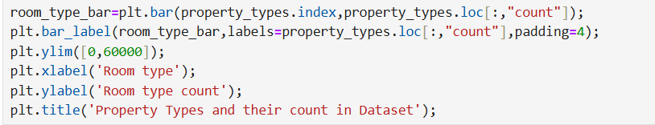
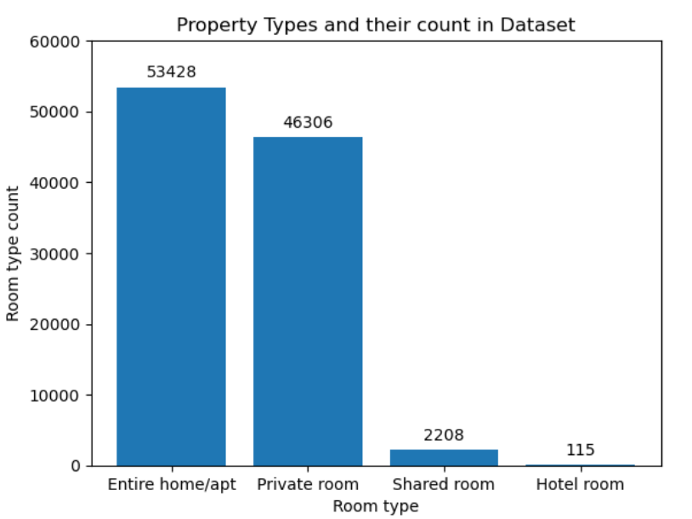
RESULTS1
Demo Link

Slide 7
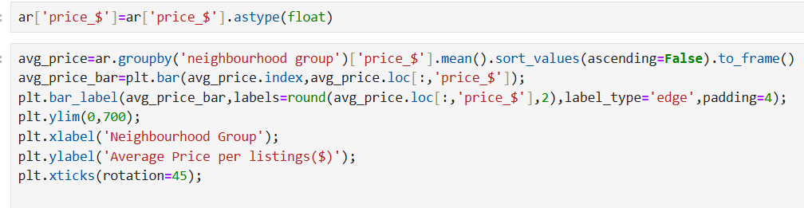
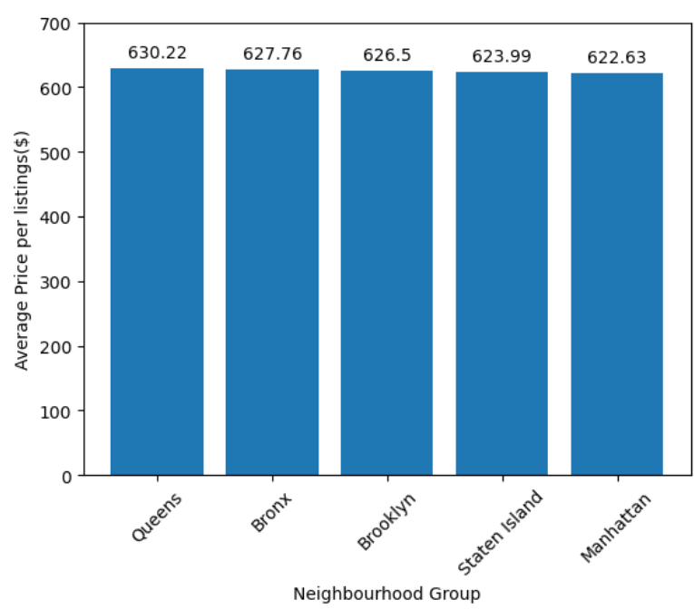
RESULTS2
Demo Link

Slide 8
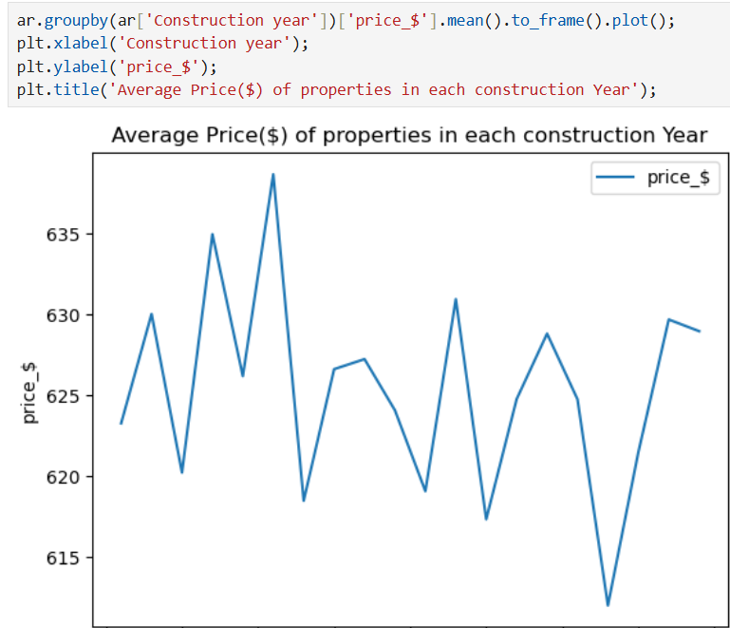
RESULTS3
Demo Link

Slide 9
GitHub repository
https://github.com/Shubham09091995/VOICE_AICTE_OCT2025_shubhambhadoria.git
Demo Link

Slide 10
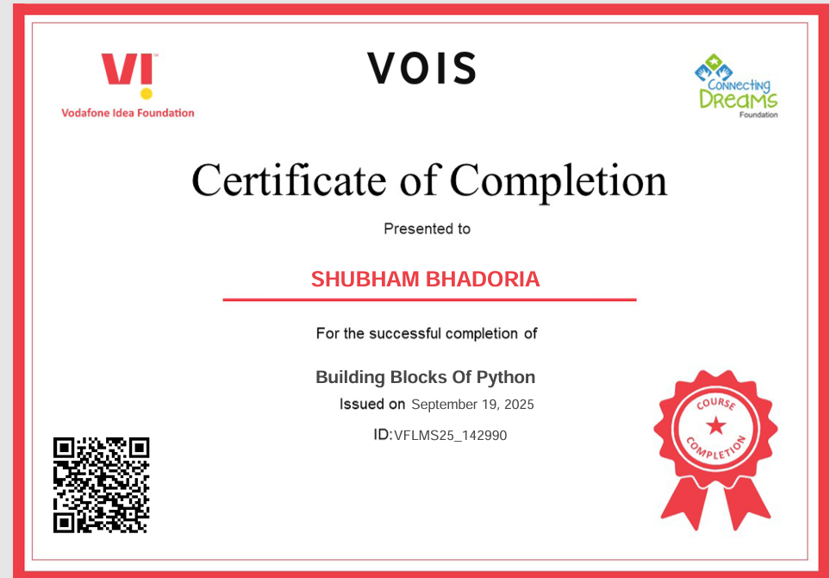
Getting started with Basics of Python Certificate

Slide 11
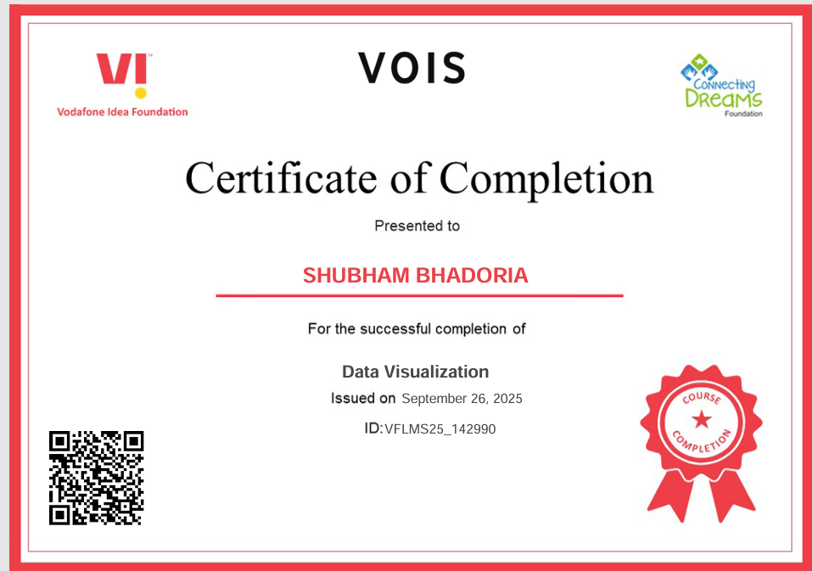
Data Visualization Certificate

Slide 12
Thank you
.
.

